Slide 1
ROI Analytics: Marketing Mix Models
Thursday Learning Hour
August 23rd, 2018

Slide 2
Introduction – What and Why of Marketing Mix….
The marketing mix is the combination of variables that a business uses to carry out its marketing strategy and meet customer needs.
The marketing mix is often called the 4Ps: Product, Place, Price, and Promotion
Market Mix Modeling is a technique which helps in quantifying the impact of several promotions on sales.
Marketing mix is used to identify the impactful promotions and optimize promotional spends
The purpose of using MMx is to understand how much each promotional channel contributes to sales, and thereby how much to spend on each channel.
It helps in ascertaining the effectiveness of each marketing channel in terms of Return on Investment (ROI)

Slide 3
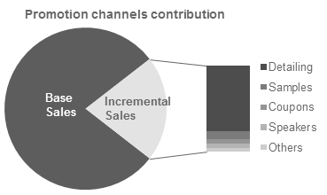
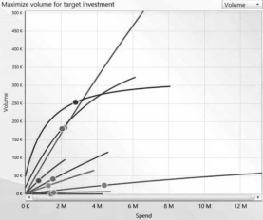
What is multi-channel marketing mix modeling?
Promotion
Response
Modeling
The entire set of activities used to communicate/publicize the brand to different set of customers
e.g., Detailing, Webinars, Samples Congresses, Mobile App etc.
The sales generated as a result of the promotional efforts made.
e.g., Units, Treatment days, Revenue, Decision to Test, Refer, or Treat
Evaluating the relationship between response and promotions through different techniques like regression; Optimizing promotional spend

Slide 4
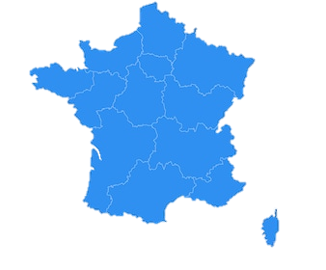
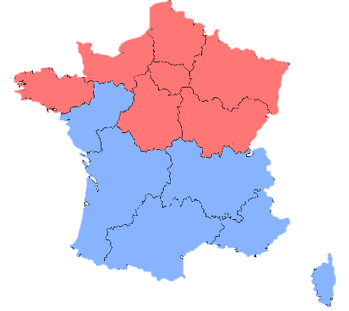




How MMx helped a global pharmaceutical company identify best executional practices in a key geography
NORTH AND NORTH EAST & PARIS
Execution of promotions must be improved with better targeting, while investments need not be increased
€ 0.3 M
SOUTH EAST AND SOUTH WEST
€ 0.4 M
With ROIs growing YoY and excellent promotional execution, investments can be increased further while maintaining the operational excellence
€ 6.1 M
€ 5.6 M
€ 2.1 M
€ 1.5 M
1100%
700%
950%
A high performing drug in France received regular promotions among HCPs in the form of detailing, speaker events and online channels such as email, webinars etc.
ROI of each channel as well as performance of various regions to the promotions was calculated to identify promotion effectiveness at granular levels
Optimized reallocation of spends that will provide maximum profit next year was calculated and provided as recommendations

Slide 5
Marketing Mix Modeling : A mathematical framework to identify factors driving sales and quantifies effectiveness
Dependent variable
Independent variables
Sales Data
Direct F2F channels
(Detailing, Local Events, Congress)
Digital channels
(Webinar, SDeD)
Other Factors
(Working Days, Market Share, Seasonality)
Marketing Mix Model
Drivers for Sales
ROI for each channel
Response Curves
Optimization
Marketing plan / channel mix optimized for greatest ROI

Slide 6
Basic Terminology
Total Year Sales
Impactable Sales
Baseline
Impact from current promotional activities
Baseline Sales: Baseline is defined as sales which would happen even when marketing activity is zero or the amount of sales which can't be directly attributed to any of marketing channel at all
Incremental/Impactable Sales: Deduction of baseline sales from overall sales leads to impactable sales, which can be understood as sales which is resultant of marketing activity
Ad-stock/Decay Effect: Measuring the memory or decaying effect of advertising over a period of time from the start of advertising
Transformation Effect(Lead-Lag): Whether a particular promotion’s effect has been observed early(lead) or late(lag)
Channel Contribution: The contribution of each channel towards the total impactable sales

Slide 7
An effective channel mix analysis process follows a structured approach
Pre-Modeling
Modeling Stage
Marketing Mix Analysis
Step 1: Identifying Data
Identify and classify media spends, promotional factors, macroeconomic and other factors
Prepare analytical data mart
Step 2: Data Quality
Quality Analysis
Variable treatments
Step 3: Exploratory Data Analysis
Seasonality
Promotional Lag / Adstock effects
Event analysis
Halo and Synergy effects
Relationship analysis
Step 4: Modeling
Mixed Modeling (for modeling containing panel data)
Linear models
Linear - Log models
Log - Log models
Step 5: Marketing Mix Analysis
Individual Contribution: Determining the contribution of each marketing channel towards sales
Spends vs. Contribution: Comparing the spends to contribution for each marketing activity
ROI: Comparing the Return-on-investment analysis for each marketing activity
Deep Dives: Understand promotion effectiveness and granular levels for individual channels
Step 6: Optimization
What-if analysis and simulation of different spend scenarios

Slide 8
EDA - Steps
Univariate Analysis
Univariate analysis explores each variable in analytical data set, separately
Bivariate Analysis
For marketing and sales performance data, it is always useful to explore bivariate relations and correlations between sales and the different marketing activities
Multivariate Analysis
Multivariate analysis explores the relation of multiple promotions simultaneously.
Factor Analysis
Factor analysis groups similar variables into dimensions.This process is also called identifying latent variables.Since factor analysis is an explorative analysis it does not distinguish between independent and dependent variables.
Time Series
Since the data is mostly in time series, such as monthly sales, monthly spend on advertisement, monthly spend on promotions, etc., it is also crucial to check stationarity of the data using various unit root tests.
Variable Transformations
There is a carryover effect and decay effect of marketing activities which can be handled through lag transformation and ad stock transformation

Slide 9
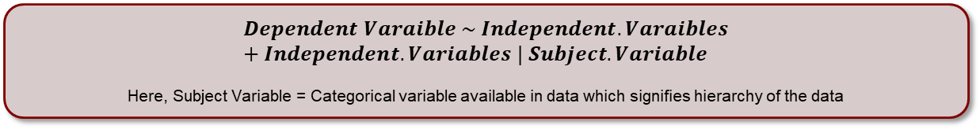
Why Mixed Models?
Mixed Effect Model
Fixed Effect (FE)
Random Effect (RE)
These considered as constants within the population. Hence, FE conveys systematic and structural differences in response. Typical linear regression is a fixed effect model as a definitive (fixed) relationship between dependent and independent variables is modeled
These are considered as stochastic and hence, RE convey stochastic differences between groups or clusters of information. For e.g. sales captured from different cities could have random effect at city level because of demographics of the city
$$Dependent Varaible \sim Independent.Varaibles+Independent.Variables | Subject.Variable$$
Here, Subject Variable = Categorical variable available in data which signifies hierarchy of the data
Defining Model Form and Expected Outcome
Random Effect
Effect type | # of Intercept Estimates | # of Slope Estimates
Fixed Effect | 1 | 1 (X1)
Random Effect | 10 (L1) | 10 (L1)
 | 50 (10 x 5 i.e. L2 within L1) | 50 (10 x 5 i.e. L2 within L1)
$$Y \sim 1+X1+(1+X1|L1/L2)$$
Model Output
Fixed Effect
Y = Dependent Variable
X1 = Independent Variable
L1 = Higher hierarchy level
(assuming10 groups)
L2 = Lower hierarchy level
(assuming 5 groups per L1 group)

Slide 10
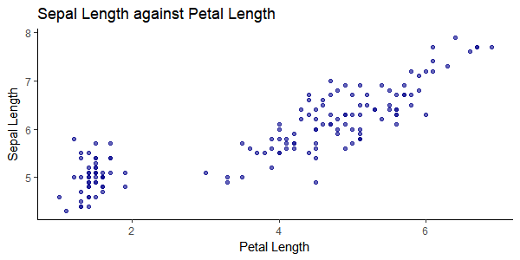
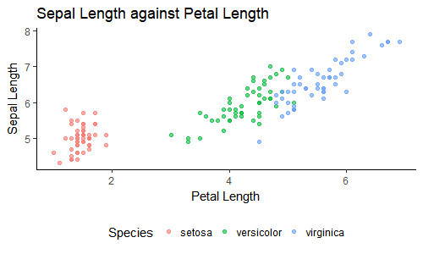
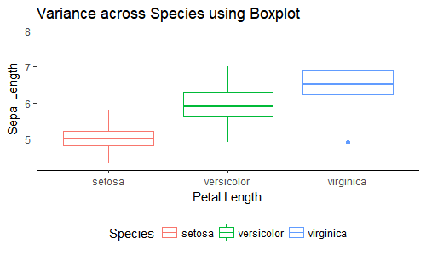
MIXED EFFECT MODEL
Data: Iris
Sample Problem: Predicting Sepal Length using Petal Length for various species
Dependent Variable: Sepal.Length
Independent Variable: Petal.Length
Subject Variable: Species
Two clusters of data can be distinctly identified, hence, maybe building two model is separately is good enough
Have you looked into all aspects of data? Is there some sort of group already available in data?
Each of the species shows very different behavior, hence, it is better to build different model for each of them

Slide 11
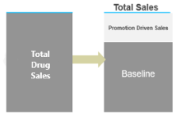
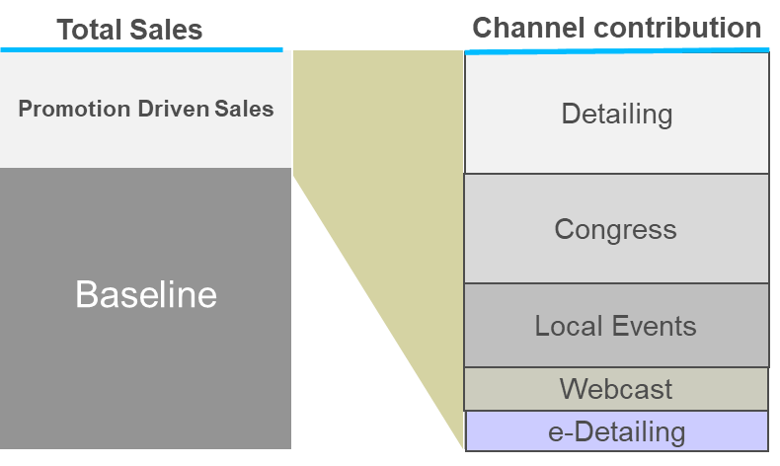
The 2 Steps modelling approach
1
Step 1 Model Equation
$$Sales=\text{β}\text{.}\text{Geo}\text{ (}\text{Total} \text{Promotions}\text{) + }\text{Baseline}\text{(}\text{brick}\text{, }\text{time}\text{)}$$
Objective: To separate out effect of promotional channels from total sales to get baseline sales and impactable sales
Baseline Sales: Measuring the expected sales without marketing efforts helps understanding the solitary power of the product itself
Impactable Sales(Promotion Driven Sales): How much of the sales are due to promotional activities
2
Step 2 Model Equation
$$\text{Predicted} \text{Sales}\text{−}\text{Baseline}\text{ = }\text{β}\text{1}\text{KV}\text{.}\text{Log}\text{(}\text{P1}\text{+}\text{1}\text{) +}\text{β}\text{2}\text{KV}\text{.}\text{Log}\text{(}\text{P2}\text{+}\text{1}\text{)…}$$
Channel Performance: Impactable sales from step-1 is used to determine the effectiveness of all promotional channels
Response Curves: Analysis the response based on law of diminishing returns for different channels
Marketing Mix Model with all Channels
(Region level Channel Performance / ROI)

Slide 12
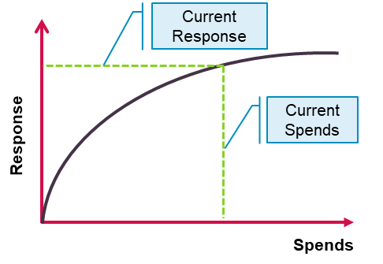

Contribution and ROI Calculation
1
Step2 Model Equation
3
Calibration Ratio
$$Predicted Impactable Sales= \exp^{(log{CH1}^{β1}+log{CH2}^{β2}+log{CH3}^{β3}+ …+log{CHn}^{βn)}} −1$$
$$Cali Ratio\left(CR\right)=\frac{Predicted Impactable Sales }{CH1 Cont I+CH2 Cont I+ …+CH3 Cont I}$$
2
Channel 1 Contribution Initial
4
Channel 1 Contribution Final
$$CH1 Contri Initial=$$
$$\left[{Predicted Impactable Sales −(exp}^{(log{CH2}^{β2}+log{CH3}^{β3}+ …+log{CHn}^{βn)}} −1) \right]$$
$$CH1 Contri Final= CH1 Contri Initial∗CR$$
Response Curve Creation
Calculate Response (impactable sales) for channel under consideration at various values of spends starting from 0 to X% of current spends
Spends for rest of the channels remains constant
Ad-stock values are used as in the step 2 model signed off
Equation used is as generated from step2 modeling
ROI Calculation
Calculate the Incremental Sales of the channel and the spends of that channel
Use following formula to calculate the ROI value
$ROI \%=((Incremental Sales−Spends)$/ $Spends) ∗100$

Slide 13
Channel Deep Dives – Sponsored participants to Congress Events generate lower ROI than others, due to poor targeting
CRM Participants
Regular participants attending by invitation
~160% ROI
€ 2,933
per International Congress
Participant
€ 419
per National Congress
Participant
Congress Participants
~80%
ROI
€ 4,340
per International Congress
Participant
€ 474
per National Congress
Participant
Sponsored Participants
Participants sponsored to attend the event
CRM Participants
Sponsored Participants
78% of participants are Detailing Targets
32% of participants are Unsegmented physicians
7% of participants are KOLs
67% of participants are Detailing Targets
48% of participants are Unsegmented physicians
14% of participants are KOLs
Event Participant Segments
High
(E1 + E2)
Medium
(E3 + E4)
Low
(E5 + E6)
Unsegmented
Observations
// ~15% of total Congress participants are sponsored participants, and the ROI obtained from these participants is lower than that from the CRM participants
// Despite being targeted for sponsoring, 86% of the participants are non-KOLs
// Almost half the sponsored participants (~48%) are Unsegmented physicians
// Better targeting of Sponsored participants is recommended to obtain better returns on the investments made on them
// Introducing lead effect of 2 and 3 months to National Congress and International Congress respectively improved model stability when sub-model was built with these channels separated
12

Slide 14
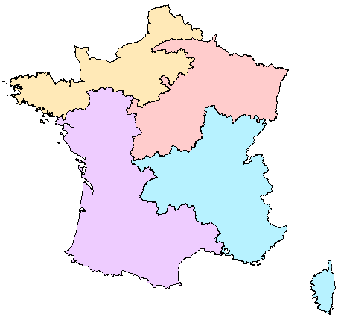
Geographical Deep Dives – North regions see a decrease in ROI YoY, whereas South regions show strong increasing ROI
NORTH
NORTH EAST & PARIS
ROI
841%
45%
790%
42%
Market Share
ROI
Market Share
15% YoY decline
3.6% YoY growth
46% YoY decline
4.3% YoY growth
Drug Sales
103 K
124 K
87 K
120 K
Competitor Sales
Drug Sales
Competitor Sales
18% YoY growth
11% YoY growth
16% YoY growth
10% YoY growth
68%
68%
68%
SOUTH EAST
68%
SOUTH WEST
ROI
955%
51%
ROI
Market Share
958%
45%
Market Share
56% YoY growth
0.5% YoY growth
63% YoY growth
0.1% YoY growth
114 K
110 K
106 K
131 K
Drug Sales
Competitor Sales
Drug Sales
Competitor Sales
16% YoY growth
13% YoY growth
15% YoY growth
15% YoY growth
Observations
Recommendations
// North regions have a lower ROI that is on a decline from the last year. Market share, however, is seen to be growing steadily YoY
// South regions have higher overall ROI that has increased significantly YoY, but has only marginal increase in Market Share YoY
// Due to YoY decline in ROI in North regions, execution of promotions must be examined prior to investments decisions
// Factors responsible for YoY increase in ROI in South, apart from increasing spends, must be identified and focused on to enable more aggressive growth to capture the market

Slide 15











What if Analysis – Optimization
Model Output
(How channels are performing)
Scenario planner
(What if Analysis)
Optimization and Insights
(Recommendations)
Private GP
Private Specialists
Hospital
What should be optimal budget allocation across channels given the business constraints at National/Channel and Region level
Executing Scenario designed to find optimal budget allocation across different channel
Local
Events
Online
Compare the results from different scenarios to provide recommendation across channel/region
National
Events
Business Constraints at National/Channel and Region level
Channels | Current Spends | New Spends
Detailing | € x | € y

Slide 16
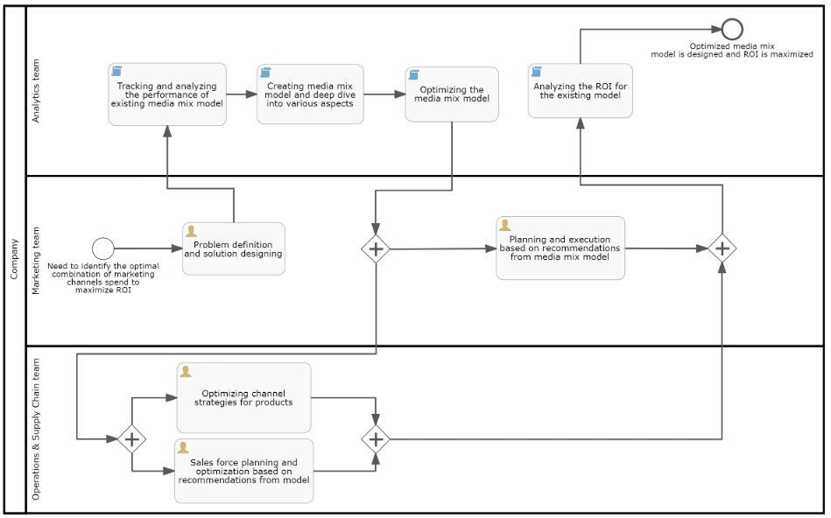
BPF

Slide 17
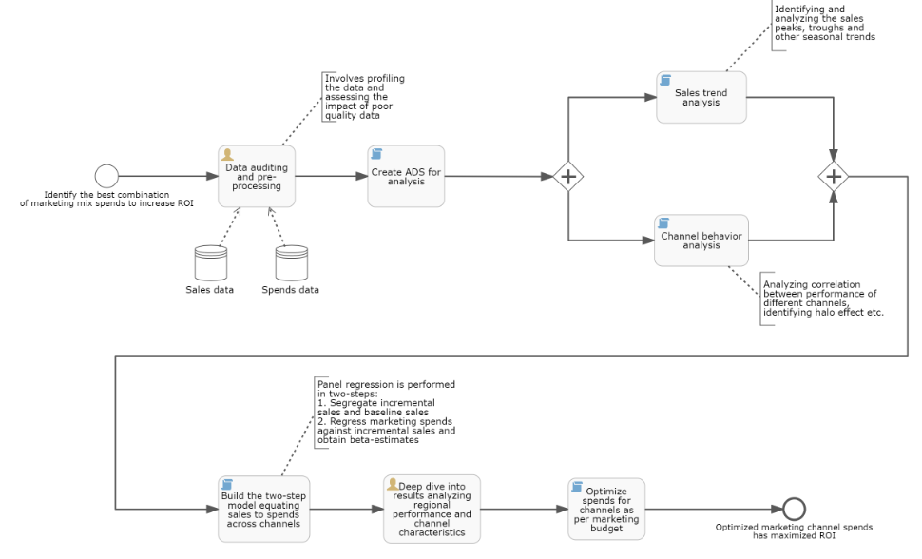
ADF

Slide 18
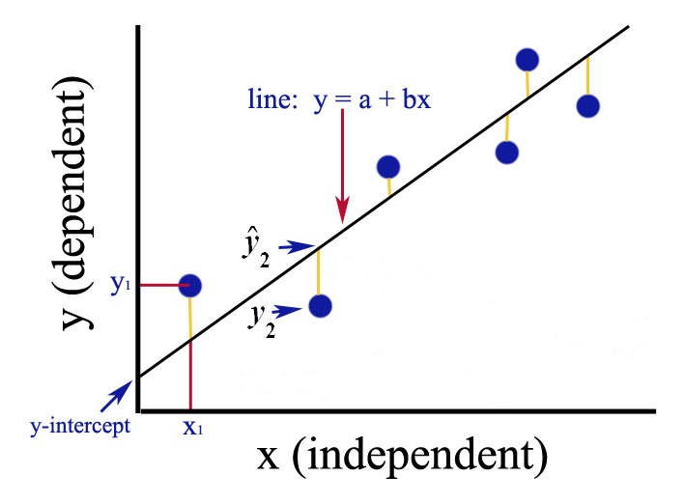
Basic predictive modeling technique: Simple linear regression
What?
What is Regression?
Quantifying the relationship between two continuous variables (y on x)
Predict (or forecast) the value of one variable (y) from knowledge of the value of another variable (x)
How?
Least square method: Calculates the best-fit line for the observed data by minimizing the sum of the squares of error (SSE) of prediction ( )
Learn more about regression…

Slide 19

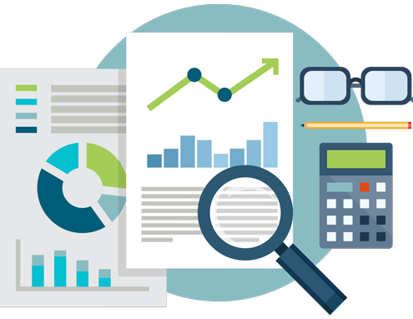
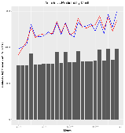
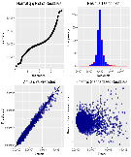
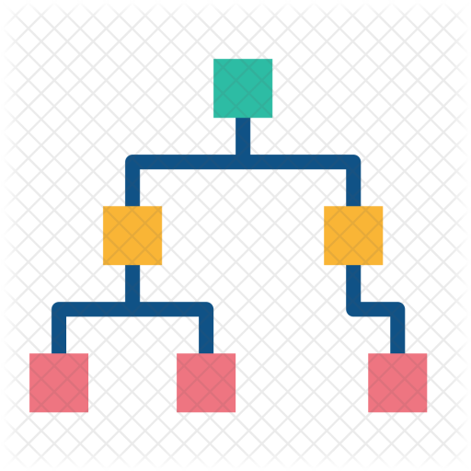
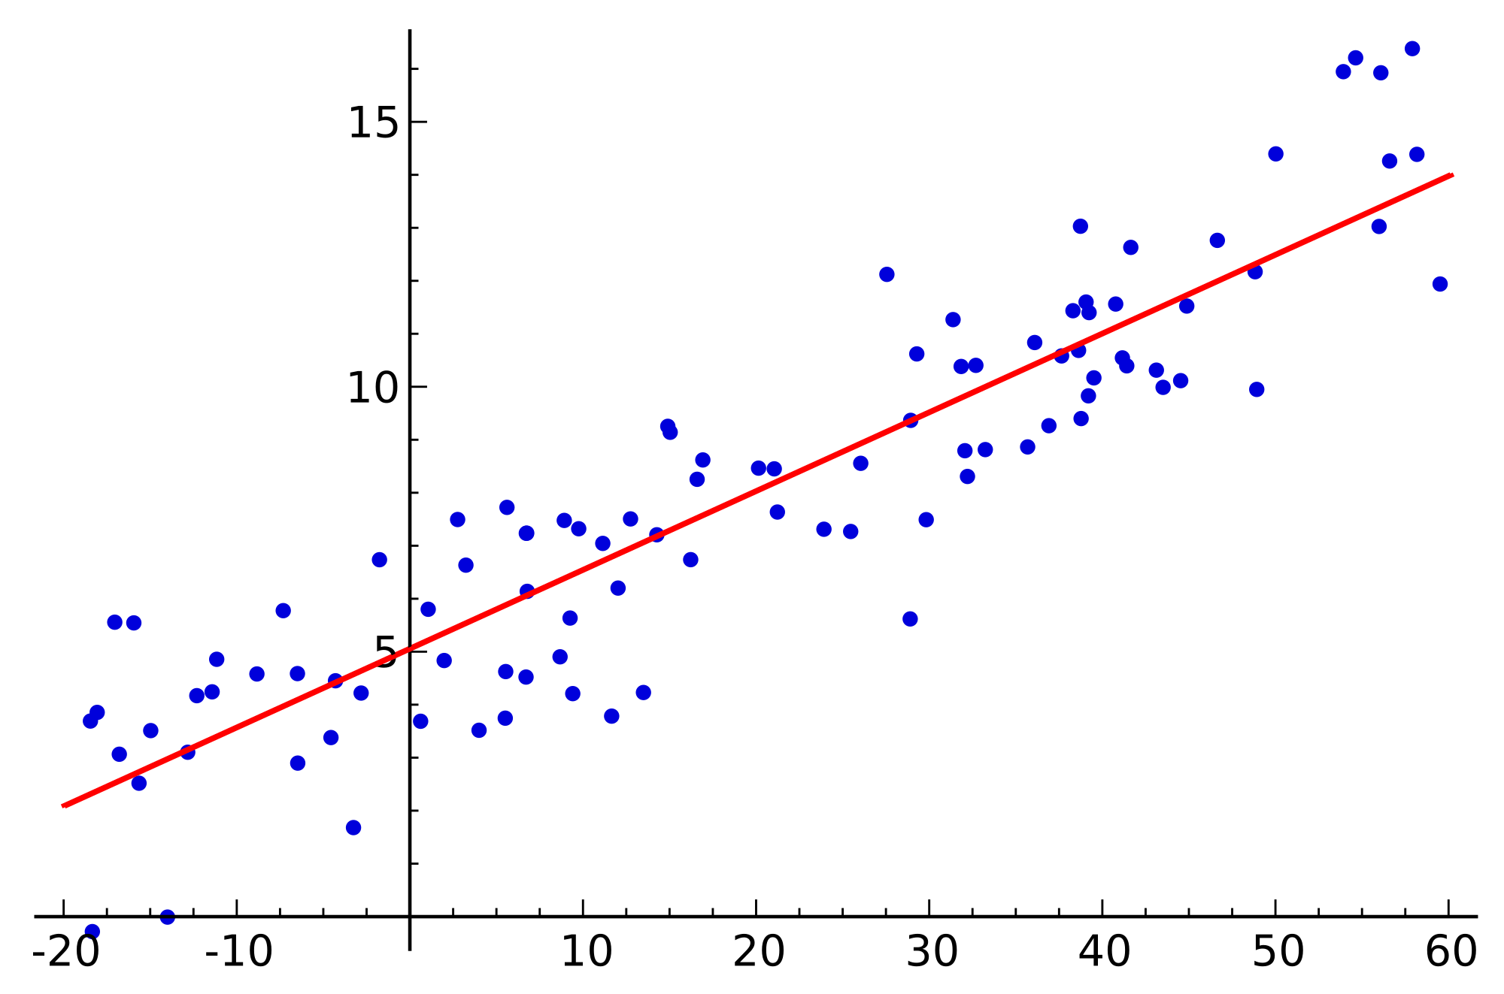

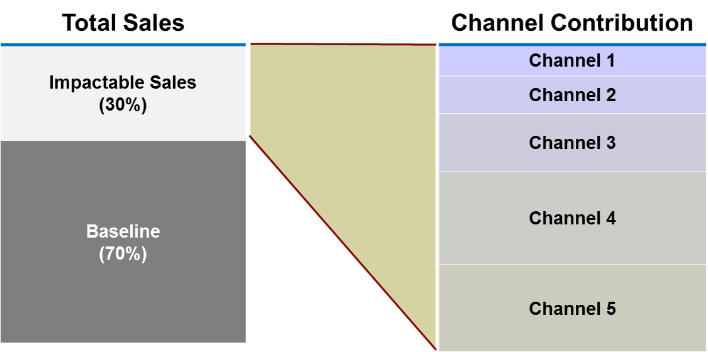
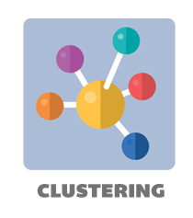
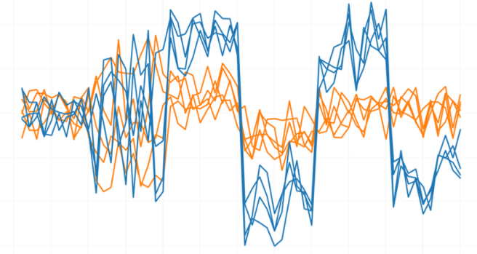
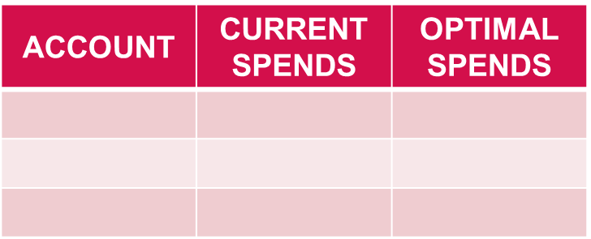
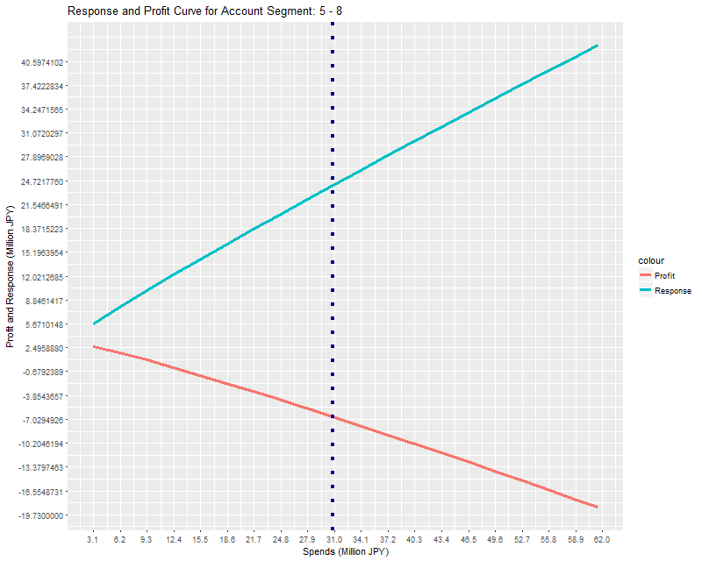
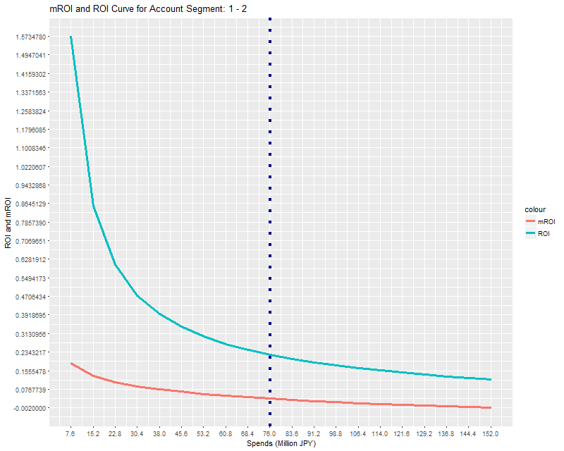


Response based model is built at a cluster level for Detailing accounts; cluster level response will be then disaggregated to account level
Account level call plan is the expected outcome
DATA SOURCE
ANALYTICAL DATASET (ADS) CREATION
RESPONSE MODELING
ACCOUNT LEVEL RESPONSE
DWH
1
4
All data at account level
Baseline Modeling (Step 1)
7
Disaggregate cluster level response to account level
Flat File
2
5
Sales value and Time series based clustering
Media Impact Analysis (Step 2)
8
Account level Call Plan
3
6
Excel File
Aggregate ADS at cluster level
Response Curve

Slide 20

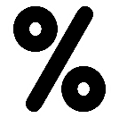
Optimization Results
Spends
JPY 15.7 B
JPY 14.6 B
Contributions
JPY 22.4 B
JPY 22.1 B
ROI
42.9 %
52.8 %
2017 Actuals vs 2018 Optimized Spends across Channels
2017 Actuals vs 2018 Optimized Contributions across Channels
1.3 B
11 M
30 M
86 M
39 M
1.1 B
279 M
25 M
13 M
58 M
28 M
155 M
Insights
Retargeted Detailing appears to be performing well, with 8% reduction (JPY 1.2B) in spends is resulting in a drop of only ~1.5% (JPY 279M) promotion driven sales
Overall spends dropped by JPY 1B however the promotion driven sales observes a decrease of only JPY 155M driven largely by the increase in spends on the rest of the channels along with within channel optimization that’s being performed

